Slide 1
GO BRONCOS!!

Slide 2
Welcome to Dr. Lȇ’s English Class

Slide 3
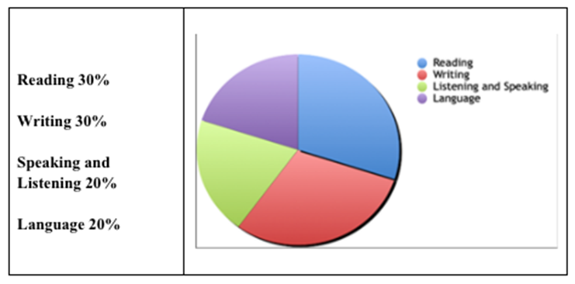
Grading Scale:
90-100% = A
80-89.9% = B
70-79.9% = C
60-69.9% = D
59.9% & below = F
(+/- used in scale)

Slide 4
Classroom Behavior Expectations
Be Kind
Be Respectful
Be Engaged
Follow Syllabus Expectations
Follow School Expectations

Slide 5
English Department Cell Phone/Electronics Policy:
Student use of cell phones, earbuds, and other electronics has become an increasingly negative disruption during classroom instruction, interfering with student learning and engagement.
In order to support and maintain an environment conducive to learning and engagement, cell phones, ear buds, and other electronics must be turned off and put away while class is in session (unless otherwise directed by the teacher for academic purposes).
Failure to comply with the cell phone/electronics directive may be considered “defiance” and result in behavioral consequences. Additionally, cell phones, earbuds, and other electronics may be confiscated by faculty and/or an administrator, and parental pickup may be required.
If you need to contact your child in case of an emergency, call the front office at (951) 894-5750.

Slide 6
BEST way to contact Dr. Lȇ:
tle@murrieta.k12.ca.us

Slide 7
Time Management

Slide 8
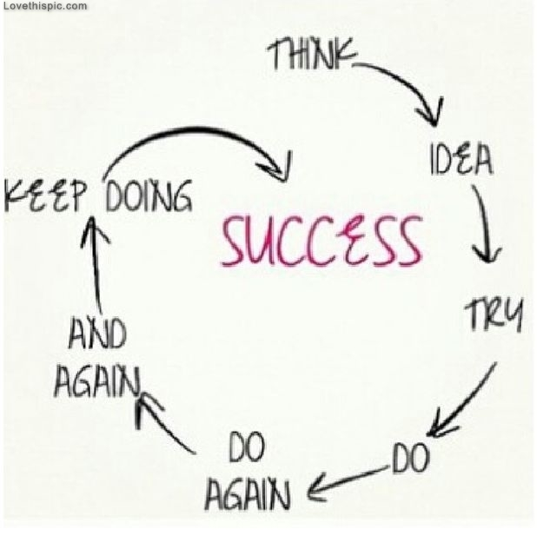
STEPS TO SUCCESS
Create SMART goals
Write down your plans physically
Prioritize your tasks
Make a realistic time estimate (Know yourself!)
Set your Calendar!

Slide 9
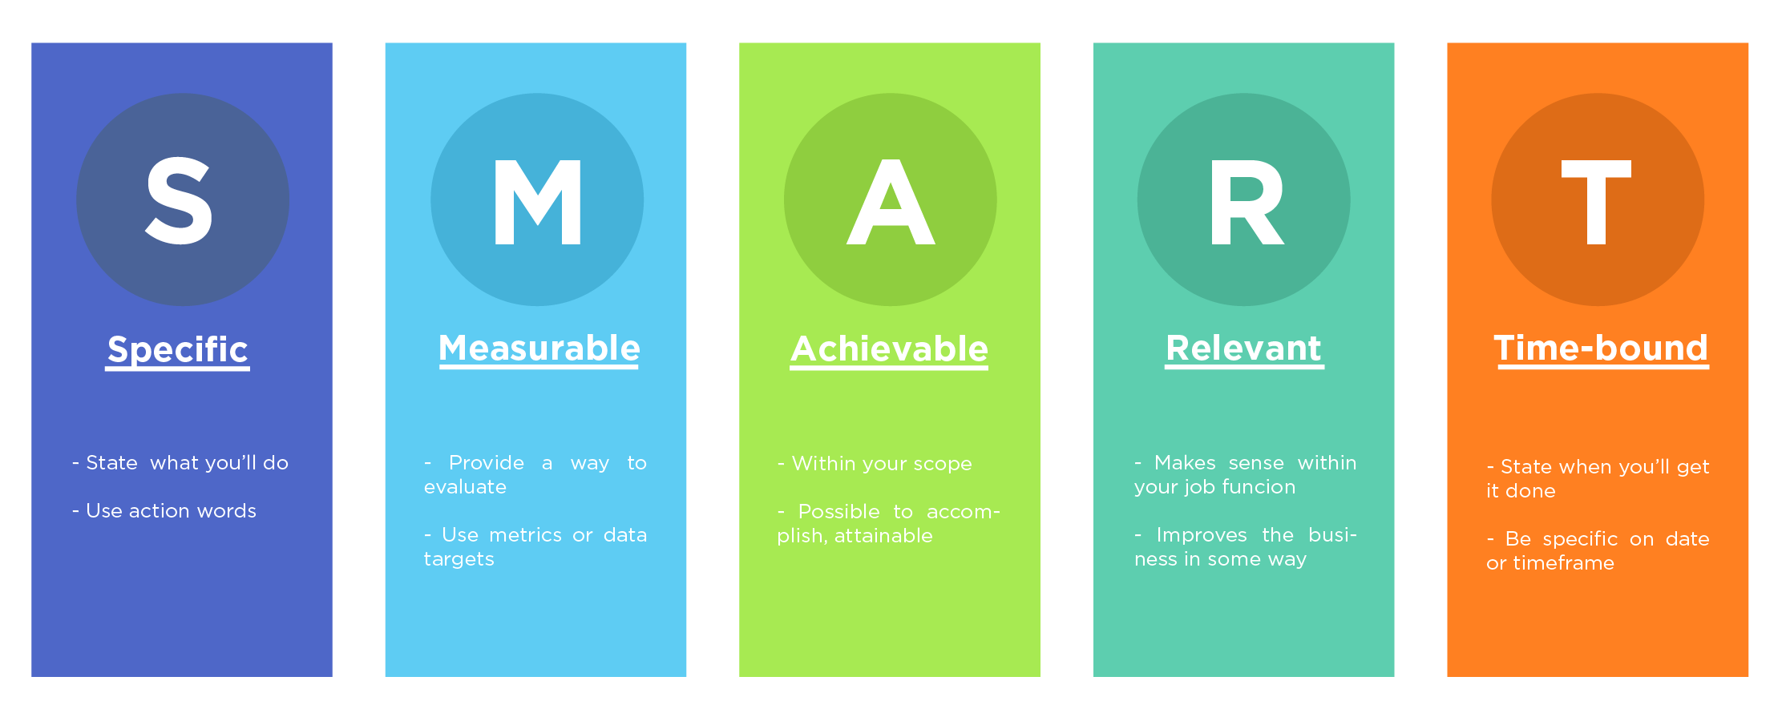
Create SMART goals
SPECIFIC, MEASUREABLE, ACHIEVABLE, RELEVANT, TIME-BOUND ex) I will go to the gym five times a week so I can lose 10 pounds in six months.

Slide 10
Write it Down!!
Write down a to do list, which will lead to prioritization USE THE BLOCK SCHEDULE Know what is coming for you, and plan ahead too

Slide 11
Know when to say no
Time management helps, but doesn’t make you have a time turner Know how much you can handle

Slide 12
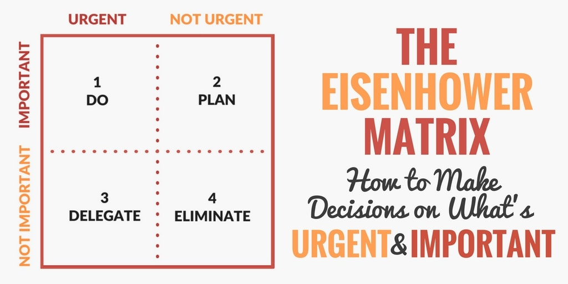
PRIORITIZE

Slide 13
Setting Aside Time
You will NEVER be 100% efficient, give yourself extra time People often underestimate how long tasks will take them - trick your brain

Slide 14
Know YOURSELF
How long do assignments take? Block off that amount of time. Make real estimates (usually around the same time for each class consistently) Do somewhat easy tasks first because getting started moves the machine - DON’T if you’re a “I deserve a break” type of person

Slide 15
TAKE A POWER NAP
Sleep is CRUCIAL in retaining memory and for your body to function. Try to sleep from 10-6. If you’re studying and you’re tired, you’re accomplishing little. Take a short 20 min nap and then get back to work being refreshed

Slide 16
Get Ready to Accomplish!
Being on a roll helps a lot in finishing tasks PREP. Get all your snacks ready and read all your notifications. This lets you consistently do your work without being distracted by other tasks.

Slide 17
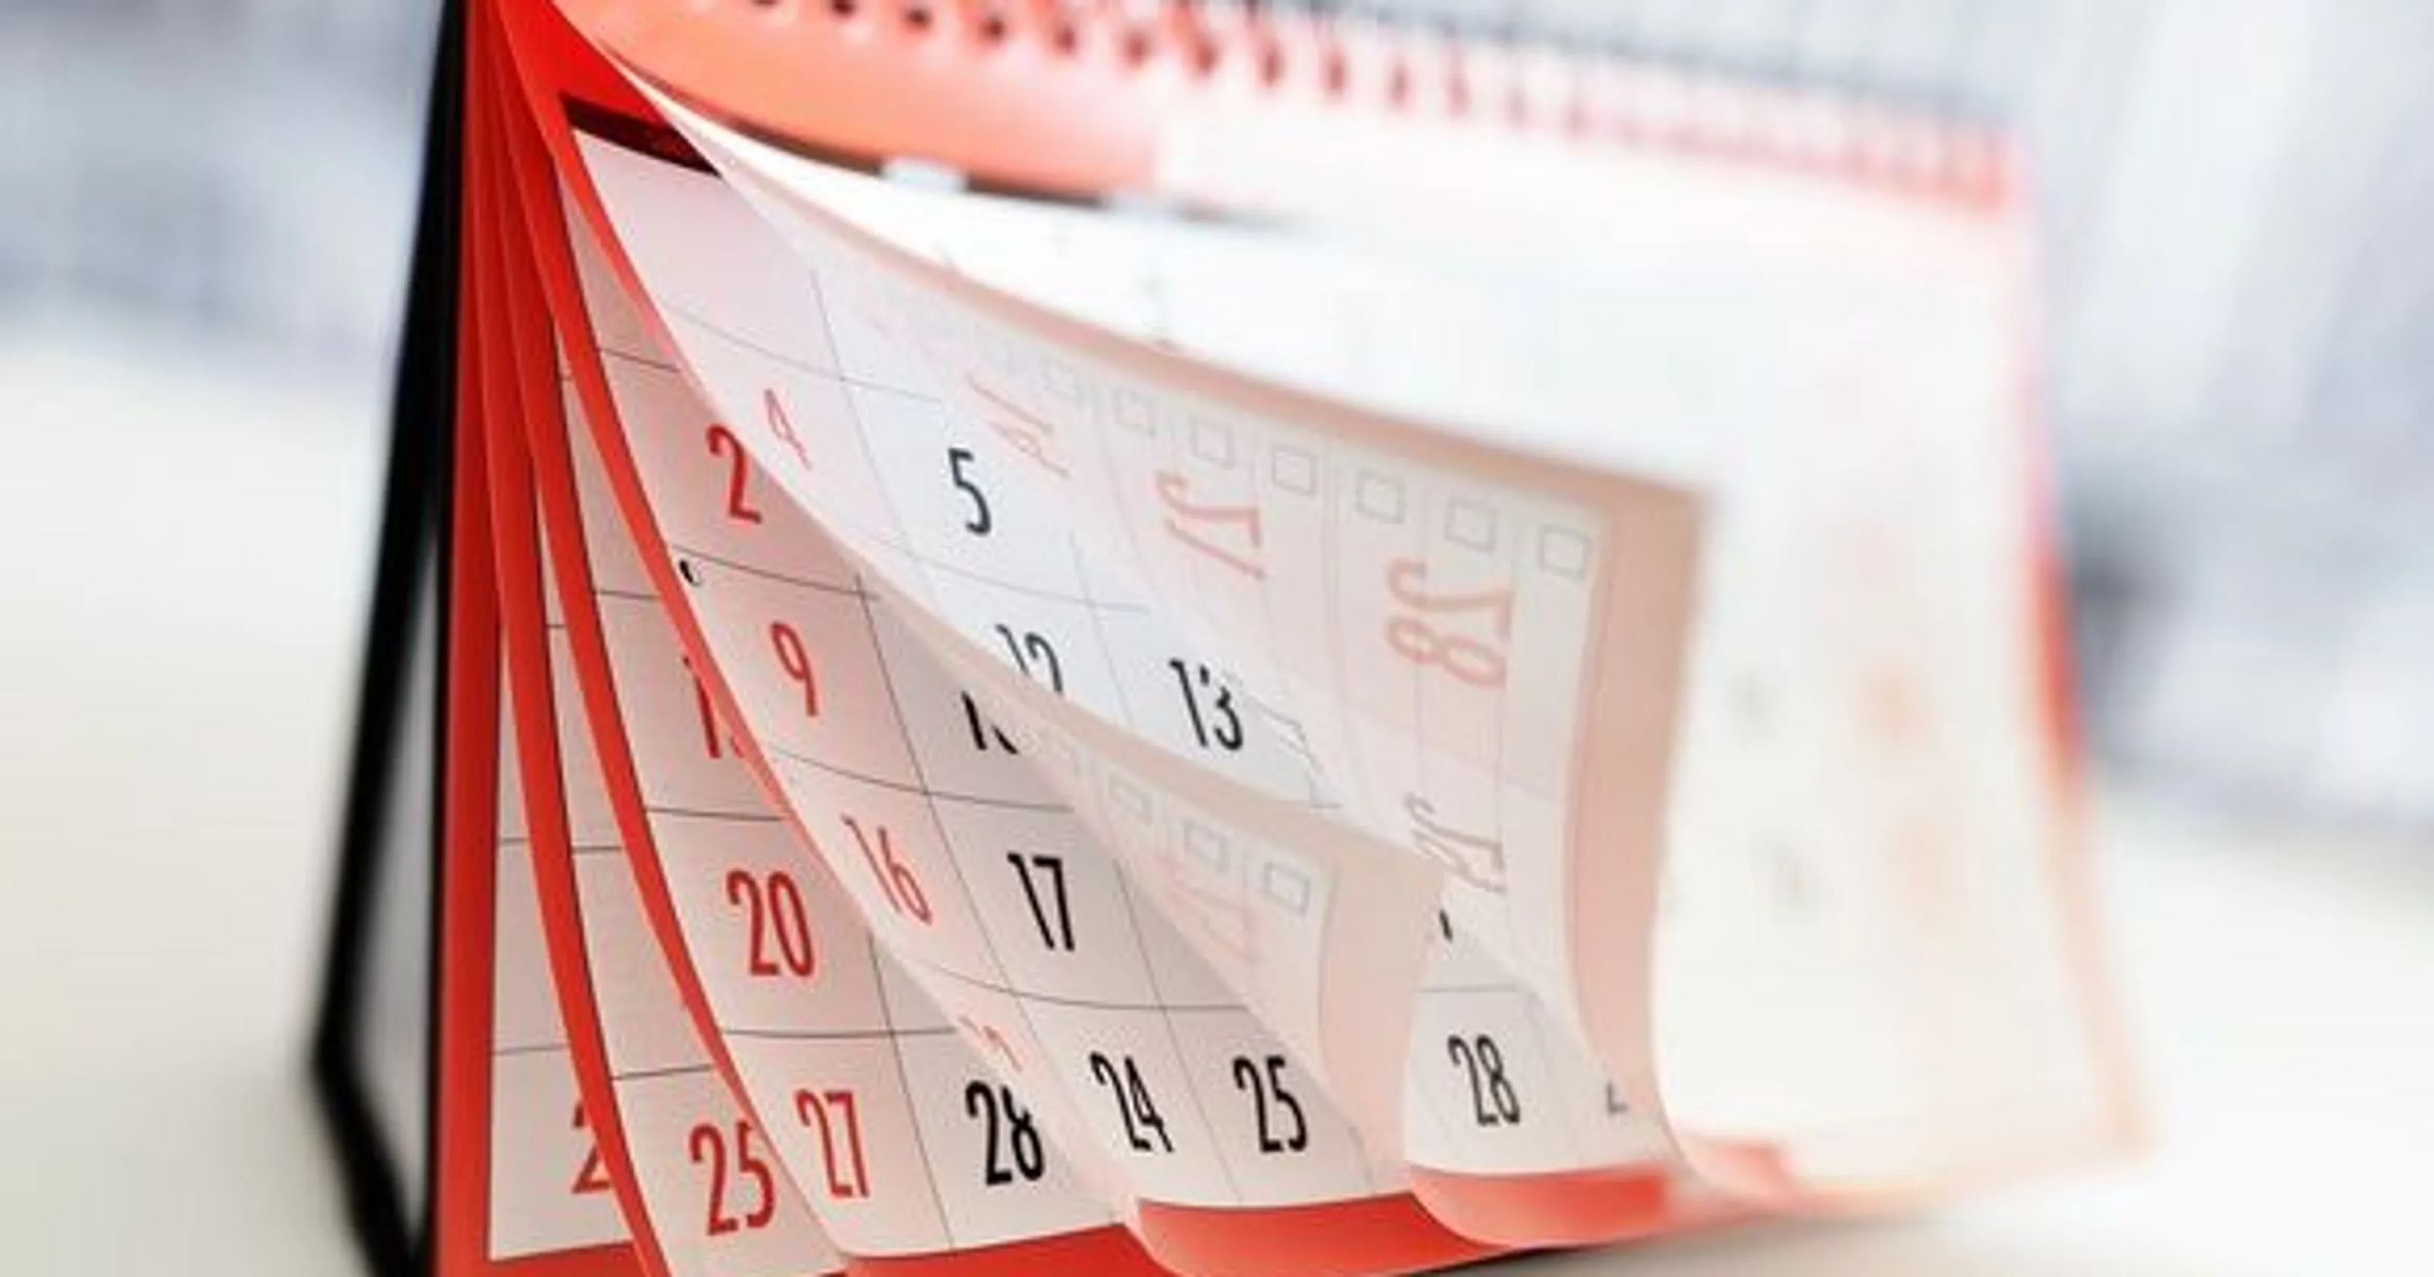
Put it in your CALENDAR
Know when things happen, and schedule things so there’s no conflict; helps you remember events in the far future

Slide 18
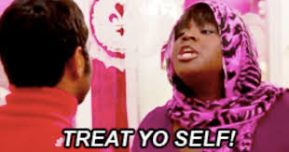
Create a BALANCED schedule
Don’t take on too much at once, or you’ll burn out and no longer be able to go on, which is WORSE than not doing one or two things in the moment You MUST set aside time for yourself. Time to be with your family, friends, and exercise is not an option, or something that takes time away from your studies. Treat yo self

Slide 19
Know Your Strengths
Know what you can do, what you can’t do, and what you’re GOOD at!

